Slide 1
LatentView Data Engineering Proposal for United Airlines
Nov 2018

Slide 2
Agenda
1
Our Understanding of United Data Migration process
2
Custom Application Development
3
Framework for Data Science
4
Adoption

Slide 3
LatentView’s understanding of United data migration process

Slide 4
Our Understanding
United Airlines will be moving to Palantir Foundry for Data Integration & CoE and LatentView can support UA in the process as per the below roadmap
Data Migration
Monitoring & Maintenance
Custom apps development
Framework for data science
Adoption
1
2
3
4
5
Moving data from existing data sources to foundry
Training
Access management & decentralization of data platform
Usage reporting
ETL management
Custom build UI/apps for reporting
New features development
Framework for modelling using technologies like datarobot, H2O etc.
Integration with other cloud technologies
Driving adoption
Support from Palantir
Support from LatentView

Slide 5
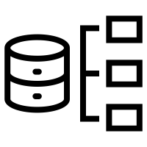






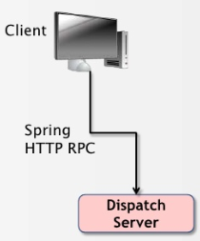

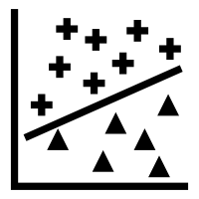







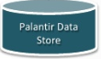



Overview & Where LatentView Can Help
Palantir
Custom Application
Analytics
Client Connection API provides the link for Searching and Extraction of Entity Objects
Unstructured or Structured Data Collaboration and Storage API’s from different sources
Hercules API
Automated Analysis
Anomaly Detection
Behavioral Pattern Recognition
Ranked Clustering
Programmatically Query, Modify, Export Information into the application
Processing, Data Management and Transformation into Palantir Data Store (ETL) as Objects
Application - Blueprint, Django & REST
Visualizations and Reporting – Plottable , D3 JS

Slide 6
Reporting / Apps Development

Slide 7








LatentView Solution for Wireframe Design
LatentView followed a well-defined methodology for designing wireframes for the reports. The design involved multiple iterations in order to balance user requirements and effort required to create the reports
Understand the audience, the business questions addressed by the reports, information to be delivered or actions enabled
Objectives, metrics and dimensions
Data Elements: Metrics & Dimensions
Layout
Hierarchy, Drill Paths, prompts
Formatting
Enhance interpretability and readability of reports with highlights, spacing, conditional formatting, conditional hiding, colors, layers
Identify data elements: The data elements include metrics and dimensions to slice, dice, drill-down and drill-across
For complex reports, define the prompts, drill paths, master-detail relationships, etc.
Presentation of information in the form of list, cross-tabs, tables, charts (of various types) using visualization best practices

Slide 8
Reporting Automation @ LatentView
LatentView created compelling content, data models, and visualizations from data spread across disparate sources. These reports can be effectively used to share, collaborate, and extend insights
One Stop Solution to understand complete campaign performance
Compare performance to prior campaigns and benchmarks
Understand performance of specific channel in real time across various dimensions
Closer coordination with ad agency as dashboard can be leveraged to optimize flighting
Flexibility of Power BI Dashboards enables marketing team to provide custom views for specific campaigns
Automated solution provides bandwidth for deeper dive on key issues
Pros
Visuals - extensive range of Interactive and custom visuals charts
Extensive Database connectivity - Excel, SQL Server, Azure, GitHub, Google Analytics, Oracle, PostgreSQL, Salesforce, Teradata, etc and integration with modelling platforms like R
Democratization of Reports, Sharing & Security makes it easy to use on all platforms and maintain data Security
Collaboration of users to build dashboard on web
Scalable solution - Dashboards created with data stored cloud accommodates growing amount of data in an efficient manner
Scheduled auto-refresh thus saving time and effort and ensuring reliable and error free insights
Business
Channel Owners
Analysts

Slide 9
LatentView’s CoE Model for a leading US based Software Giant
Objective
To develop an integrated dashboard that provides insights into marketing campaign performance
Improve efficiency of Reporting Solution by enabling end-to-end self serving BI dashboard with an automated refresh schedule
Inform Business
Understand Performance of campaigns and marketing initiatives
Provide constant feedback to ensure business KPI’s are met
Understand Customer Interactions
Leverage data to understand and marketing performance
Guide business decision making for future activities
Solution
Marketing Analytics
Leverage Power BI to generate an interactive Dashboard across multiple data sources Cosmos, SQL/Azure, flat files
Provide multiple necessary data cuts at various levels of granularity to provide visibility on campaign performances (channel performance, device-wise performance, etc.
Hosted on PowerBI site and shared across stakeholders
Guide Channel Owners
Understand specific channel performance
Optimize spend at a channel level to support overall business goals
Notes:
Input from Microsoft team required. In 2-3 slides we need to explain the story starting from transition from excel reports to Power BI, challenges faced, adoption and finally benefits

Slide 10
Framework for Modelling

Slide 11




LatentView Framework for Modelling
Data
Pre-Processing
Modelling
using Datarobot
& H2O
Getting the
results / output
Rolling Back the results to the system
Users
User login
User Activity Log
AWS Platform
Exporting Data from Palantir
Output Data sent to Palantir
UA Data Sources
Data can be exported in formats like XML, HTML , Excel / csv
Palantir Foundry

Slide 12
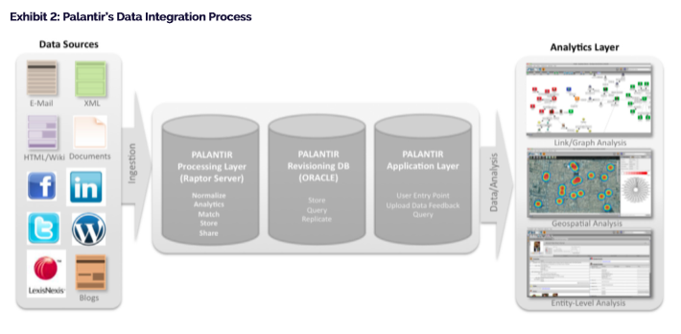
Palantir Framework for Analytics

Slide 13

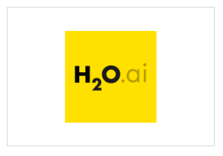
AWS Machine Learning Partner Solutions
APN Partners enabling data scientists and machine learning practitioners with tools to take their data, train predictive models and make predictions on new data
DataRobot
DataRobot for AWS offers an enterprise machine learning platform that empowers users of all skill levels to make better predictions faster. Companies of all sizes can deploy and scale DataRobot Cloud on AWS or on their Amazon VPC.
DataRobot captures the knowledge, experience and best practices of the world's leading data scientists, delivering unmatched levels of automation and ease-of-use for machine learning initiatives. DataRobot enables users to build and deploy highly accurate ML models in a fraction of the time.
H2O.ai
H2O is a fully Distributed In-Memory Machine Learning platform that supports the following algorithms: GLM, Distributed Random Forest, Gradient Boosting Machine, Deep learning, K-means , PCA, and more. It is extremely easy to use from R, Python & H2O Flow.
H2O.ai is focused on bringing AI to businesses through software. We are one of the leading open source platforms that makes it easy to deploy ML and predictive analytics to solve complex problems.
https://aws.amazon.com/machine-learning/partner-solutions/
Notes:
https://aws.amazon.com/blogs/apn/integrating-with-amazon-sagemaker-using-built-in-algorithms-from-external-applications/

Slide 14
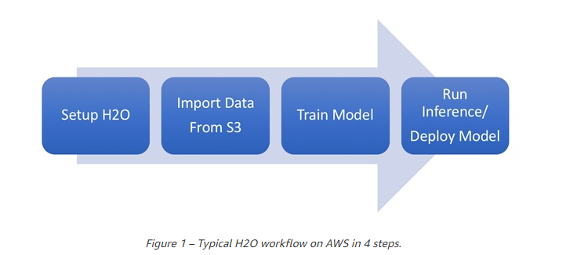
Deploying Machine Learning Models on AWS Using H2O
H2O is an open source data machine learning platform that provides a flexible, user-friendly tool to help data scientists and machine learning practitioners
To fully harness the power of H2O it should be deployed as a distributed application. This makes AWS the perfect choice for the deployment of H2O, which can be easily deployed directly from AWS Marketplace
https://aws.amazon.com/blogs/apn/4-steps-to-train-and-deploy-machine-learning-models-on-aws-using-h2o/

Slide 15
Adoption

Slide 16
Illustrative Roadmap for Adoption of Analytics CoE
As analytics deployment transitions through these waves, the challenge is to sustain momentum and showcase value continuously
 | Initiate Success | Consolidation | Expansion
Objective | Small initiatives, quick wins | Deploy analytics solutions for usage by business. Reduce the no of reports | Democratize analytics solutions across enterprise
Scope | Focus on actionable pilot projects that have the support of the business and where success can be quickly measured | Focus on multiple large analytics solution deployments across different divisions | Focus on automated decisioning, self-serve solutions, machine learning
Industry Status | Many firms have completed or in the process of completing this wave | Analytics savvy firms are pulling ahead. Some of the traditional firms are in early stages | ‘Analytics as Foundation’ firms like CapitalOne, Google are in this stage. Some of the traditional firms have built it in pockets

Slide 17
Thank You
ganesh.sankaran@latentview.com

Slide 18
Appendix

Slide 19
What LatentView Can Do ?
Data Understanding
Low
High
LatentView by virtue of having executed multiple engagements in the Consumer Insights space has a very good understanding of data elements which ensures a faster time to market & high quality analytics deliverables
Analytical Frameworks
Shallow
Comprehensive
LatentView has built comprehensive frameworks in the areas of Visualization, Social Analytics & Predictive Modelling which can be leveraged for all analytical initiatives across the globe
Chatbot Demo
Relationship Strength
Low
High
LatentView has been working with Revlon recently and has built good credibility with business stakeholders across business functions
Tableau Demo
Analytics Competency
One of many
services
Core Focus
LatentView is a boutique analytics service provider and so has people who are highly skilled in areas like Visualization, Text Mining, Predictive modelling
Notes:
Add: Demo links of one visually appealing tableau dashboards either from pepsi or mead Johnson : Pepsi : https://10az.online.tableau.com/t/latentviewanalyticscorporationdemo/views/PAID-AdvancedDiagnostics/SupplyChainHealth?iframeSizedToWindow=true&:embed=y&:showAppBanner=false&:display_count=no&:showVizHome=no
Add: Chatbot link for demo : http://ec2-52-200-210-195.compute-1.amazonaws.com:5000/

Slide 20





Maturity of BI CoE model
Stage 5
Technological advancements like chatbot
Stage 4
Reporting via BI tools like Tableau / Power BI / DOMO
Reporting via BI tools like Tableau / Power BI / DOMO
Stage 3
BI CoE Model
Data engineering, accumulation of data at one place
Data engineering, accumulation of data at one place
Data engineering, accumulation of data at one place
Stage 2
Identifying and Monitoring the consumption
Identifying and Monitoring the consumption
Identifying and Monitoring the consumption
Identifying and Monitoring the consumption
Stage 1
Understanding & Analyzing
Understanding & Analyzing
Understanding & Analyzing
Understanding & Analyzing
Understanding & Analyzing
Analysis Maturity
Notes:
Curve showing how BI CoE grows
Step1: Understanding and analyzing the needs of various BU’s
Step2: Identifying and Monitoring the consumption of various reports by BU’s
Step3: Data engineering, accumulation of data at one place for ease of use and efficient data analysis
Step4: Reporting via BI tools like tableau, power BI, Domo etc.
Step5: Technological advancements like chatbot
Abhineet has created a similar slide in the past for Mead Johnson

Slide 21
Business Objective
Business Context
UA is planning for a Data Migration to Palatir Foundry and would like to develop reports and customized apps in that platform
Also, UA would like to design the framework for integrating technologies like Datarobot & H2O in Palatir Foundry environment
Objectives
LatentView proposes to build a centralized solution and framework encompassing the reporting , app development, modelling and adoption automated and consolidated visualization and reporting solution.
The work plan includes :
Automated and consolidated visualization for reporting solution
Designing Wireframes & Integration of technologies like Datarobot & H2O in Palatir Foundry
Framework for adoption

